Slide 1
School Health Advisory Council (SHAC) Annual Report to the Board of Trustees
May 16th, 2022

Slide 2
Resource for the Board of Trustees/District
Campus Support
Help schools meet community involvement mandates and community expectations
Encourage Collaboration
Provide a way for parents and community members to work together with school personnel to accomplish district goals, utilize community resources and assets
Building Capacity
Educate community members to be a credible, collective voice for healthy children and youth
Grow Wellness
Foster cooperation by building trust and consensus among grassroots organizations, community segments, and diverse citizens
Provide Health & Wellness Resources
Provide a forum for sharing youth health information, resources, perspectives and a range of advice
Notes:
Program Implementation
Presenter: Melanie Anbarci
Time: 30 sec
Good Evening Dr. Whitbeck, President Rosenthal and members of the board.
First, I’d like to thank the Board, Superintendent and FBISD Administration for your continued support of SHAC. As you know, FBISD SHAC acts in an advisory capacity to the BOT and works closely with the Superintendent and Administration using the:
Whole School, Whole Child, Whole Community or “WSCC” model,
BOT Goals, and
The FBISD Profile of a Graduate attributes to work toward achieving the FBISD Wellness Policy goals.

Slide 3
SHAC Goals
Campus Wellness Committees
Student Wellness Committees/Coalition
SHAC
Liaisons
Policy and Campus Improvement Support
Evaluate FFA(Local)
Enhance Communications
Assisted with the development of the Whole Child Health Wellness Plan Standard Operating Procedures
Incorporate updated FFAE, EHAA, and FFA (Operating Procedures) into current CIP strategies and objectives
Promote wellness programing and events within the district.
Share resources and best practices
Highlight success stories with SHAC Recognition Awards to recognize those who grow campus wellness
Promote and support development of Campus Wellness Committees
Promote utilization of wellness resources, such as the Virtual Healthy School (VHS)
Support development of campus Student Wellness Committees and District Coalition to advance student-led wellness initiatives
Identify SHAC Liaisons for each campus
Strengthen campus level feedback regarding wellness needs
Support Campus Wellness Committees and Student Wellness Committees
Evaluate FFA(Local) based on wellness concerns identified in FBISD Campus Wellness Surveys, the Pride Survey and Naviance results (and other available assessments)
Recommend relevant resources and best practices
Notes:
Program Implementation
Presenter: Melanie Anbarci
Time: 30 sec
Say: This year, our main focus was on supporting the development of the CWCs and SWCs
Board goals below, if needed during Q & A
GOAL 1: Actively promote and support development of Campus Wellness Committees in line with FFA (Local) to help ensure successful implementation of wellness strategies by promoting utilization of wellness resources, such as the Virtual Health School (VHS), to enhance the campus wellness environment and help achieve CIP wellness goals in accordance with FBISD District Goal 4.
GOAL 2: Actively promote and support development of campus Student Wellness Committees and the District Student Wellness Coalition to help advance student-led wellness initiatives to enable students to reach their full potential in accordance with FBISD Core Beliefs and the Profile of a Graduate.
GOAL 3: Continue actively identifying SHAC Liaisons for each campus to strengthen dialogue and facilitate continuous feedback regarding campus level wellness needs in order to provide relevant resources and support to the campus as well as support for student led wellness initiatives by Student Wellness Coalitions to enable students to reach their full potential in accordance with FBISD Core Beliefs.
GOAL 4:Promote incorporation of updated FFA (Operating Procedures) into current CIP strategies and objectives, to aid in the process of implementing, evaluating and improving the campus wellness environment in order to help equip students with skills for life in accordance with the Profile of a Graduate.
GOAL 5: Continuously evaluate FFA(Local) based on wellness concerns identified in FBISD Campus Wellness Surveys, the Pride Survey and Naviance results (and other available assessments) in order to recommend relevant resources and best practices that will equip the entire District with the life skills required to promote a whole child approach to learning, teaching and community engagement in accordance with FBISD Strategic Plan Core Beliefs and Commitments.
GOAL 6: Establish and develop standard SHAC communication channels throughout the District in order to share resources and best practices as well as highlight success stories with SHAC Recognition Awards to recognize campus groups, individual wellness champions and community partners who apply resources and knowledge to grow wellness on their campus, in the District, and whom further foster the development of students to exemplify the FBISD Profile of a Graduate.

Slide 4
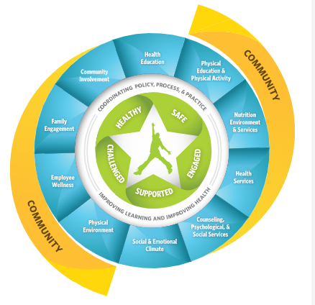
SHAC Subcommittees
Health & Physical Education
Family & Community
Social Emotional Learning (SEL)
Staff Wellness
Nutrition
Health &
Safety
Advocacy
Notes:
Program Implementation
Presenter: Melanie Anbarci
Time: 30 sec
Say: A major part of our Whole Child Health/WSCC approach to wellness is implemented through the collaboration that occurs within and between our subcommittees, among members of administration, parents and community members. Although we had a few setbacks, thankfully, most of the subcommittees were able to effectively collaborate to meet their goals.

Slide 5
What we have done
Campus Wellness Committees – Specialist Wellness, Health & Prevention
Adoption of Health & PE Instructional Resources through Proclamation 2022
Development of Whole Child Health Wellness Plan Standard Operating Procedures (SOPs)
SHAC Campus Liaisons
Student Wellness Coalitions
Notes:
Program Implementation
Presenter: Melanie Anbarci
Time: 1 min
Say: Some of the main accomplishments this year were:
Program Implementation
Presenter: Melanie Anbarci
Time: 1 min
Some of the main accomplishments this year were:
the growth and development of the Campus Wellness Committees, which are instrumental in identifying wellness goals for the Campus Improvement Plans This would not have been possible without your support and the approval of our previous request for a FTE to assist with these efforts
Participation in Proclamation 2022 review of new health textbooks for recommendation to the BOT - recommended electronic resources be added for public access to textbooks which made public participation easier
Assisted with development of SOP to implement Wellness Policy
Maintained SHAC Campus Liaison program
Reviving the Student Wellness Committees at each high school and the District Coalition leadership program to develop and support student ownership of learning and leadership skills.
Continued partnering through subcommittees to develop initiatives, vet resource and review programs - a summary of highlights, hurdles and hopes from the various subcommittees in your packet for more information

Slide 6
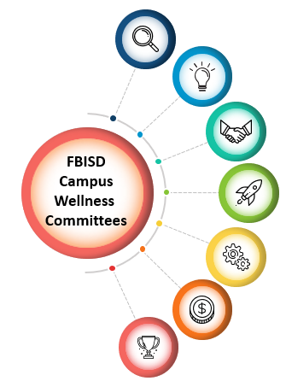
Campus Wellness Committees & Campus Impact
Creating A Campus Wellness Committee
Assessing Campus Wellness Needs
Setting Unique Campus Wellness Goals
Tracking Wellness Goal Progress
Promoting Health & Wellness on Campus
Notes:
Time: 2 minutes
Speaker – LaDonna Green
Say: Good afternoon. It has been my pleasure to work with the campus wellness committees as they advocate to make schools a better place for students, faculty, and staff. The committees have made so much progress during this school year and I am proud of the work that they are doing. We were able to work with campuses to start a Campus Wellness Committee at the campuses that did not have one and empower those that already existed.
Campus Wellness committees are made up of 5 to 10 members, including parents, teachers, administrators, nurses, family engagement coordinators, students, and community members.
Campus wellness committees assess the unique needs of their campus to determine campus wellness strengths and weaknesses. The assessments cover topics like nutrition, mental health, physical activity, and staff wellness. Elementary, middle, and high school assessments are aligned with the requirements of FFA(Local).
Based on the results of the campus wellness assessment, campus wellness committees can define goals that suit the unique needs of the campus.
As campus wellness committees set campus-based wellness goals, committees also begin to document starting points in order to show progress over time.
Campus wellness committees promote physical, mental, and social health by planning wellness events and promoting health education.

Slide 7
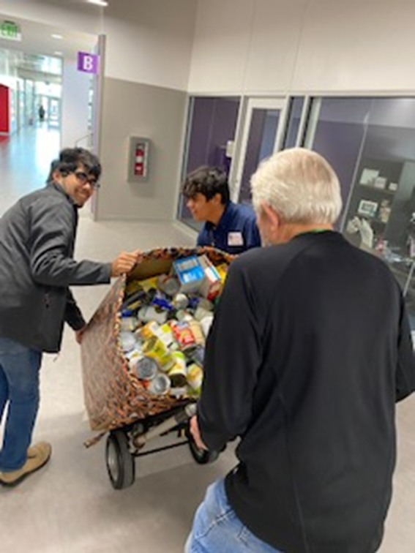
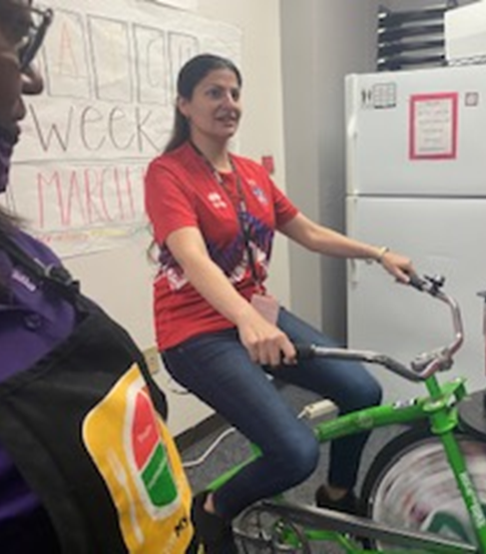
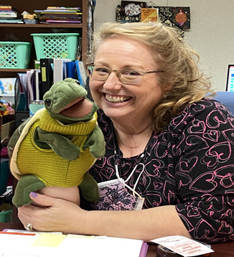
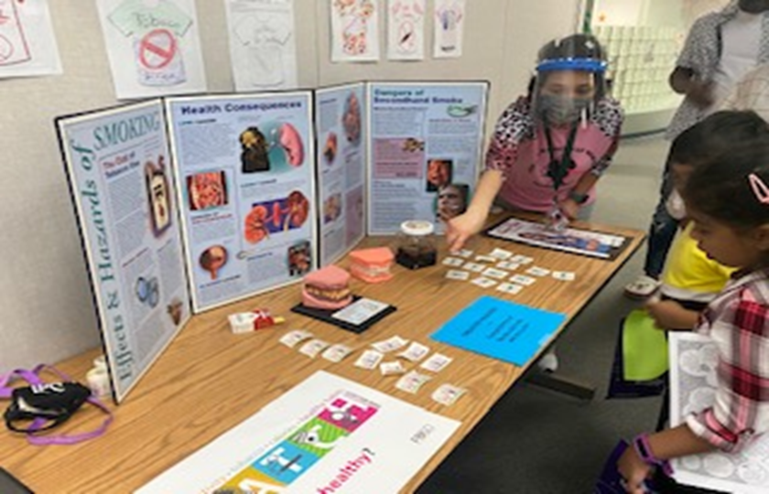
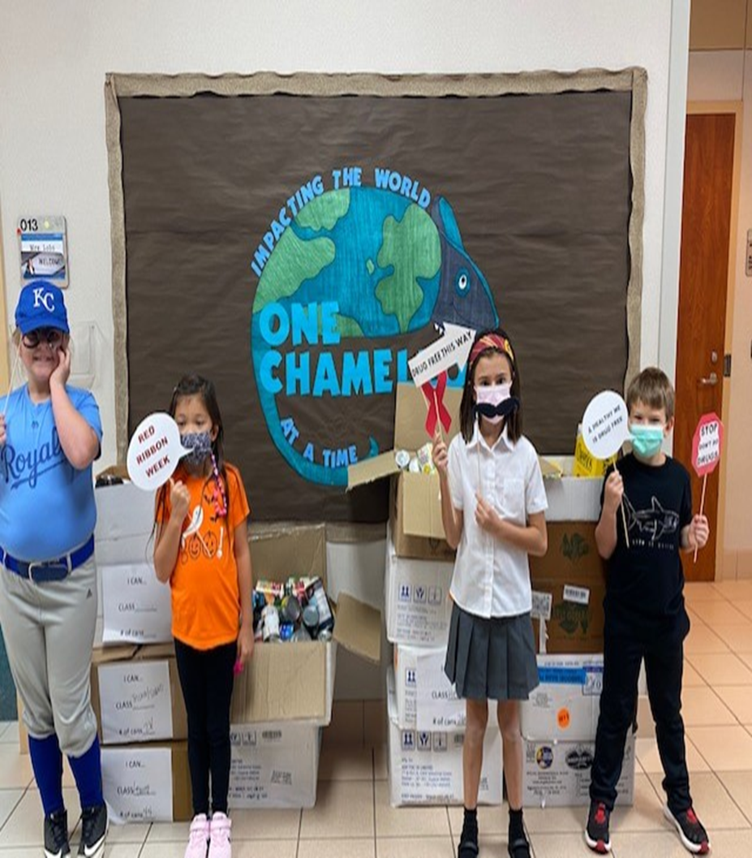
Campus Wellness Committees & Campus Impact
James Reese Center's food drive collects 2,275 pounds of food to donate to the food bank
Bowie Middle School promotes health with health announcements and contests
Austin High School promotes staff wellness by bringing in a smoothie bike
Tommy the Turtle gives mental health tips and mindfulness moments during the announcements at Lakeview Elementary
Brazos Bend Elementary hosts a health fair to make sure families are educated on health & wellness
Corner Stone Elementary Junior Committee Members host a can good drive to give back to the community
Notes:
Time: 3 minutes
Speaker – LaDonna Green
Say: The campus wellness committees were asked to have 3 goals throughout the school year, and from those goals came many health and wellness events that kept the students and staff engaged and learning healthy habits.
These events included health fairs, food drives, wellness competitions, running clubs, meditation moments, smoothie bikes for staff wellness, and morning announcements on topics like nutrition, social emotional learning, and physical activity.
Introduce Next Speaker: We would like you hear directly from one of our Campus Wellness Committee Leaders Angela McQuilken from Holley Elementary.

Slide 8
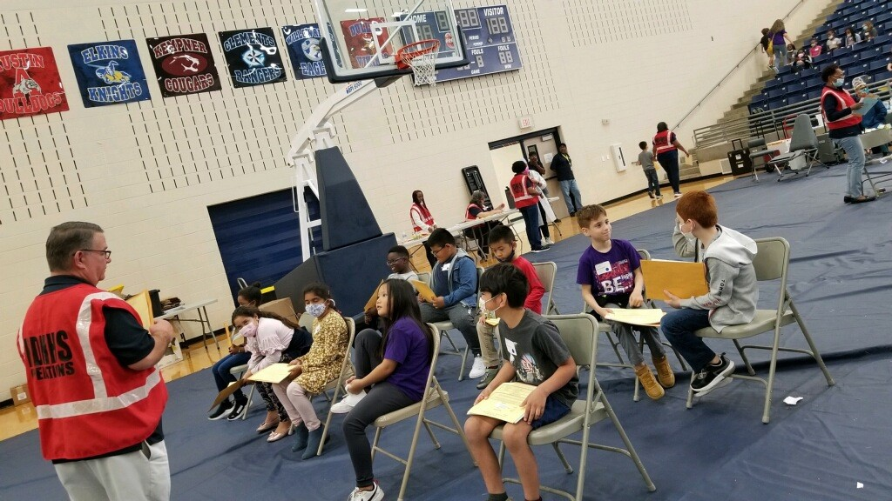
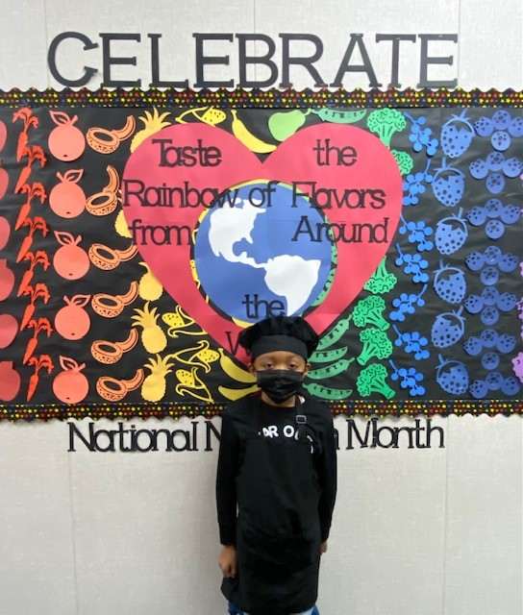
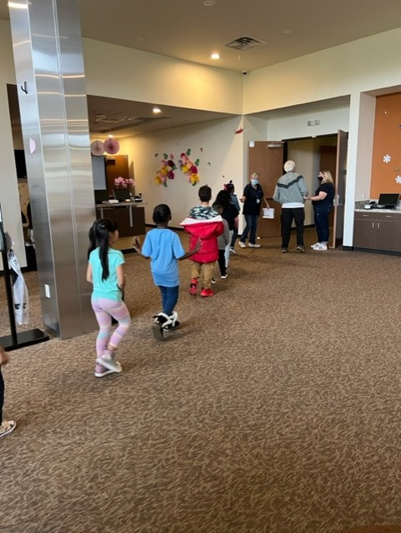
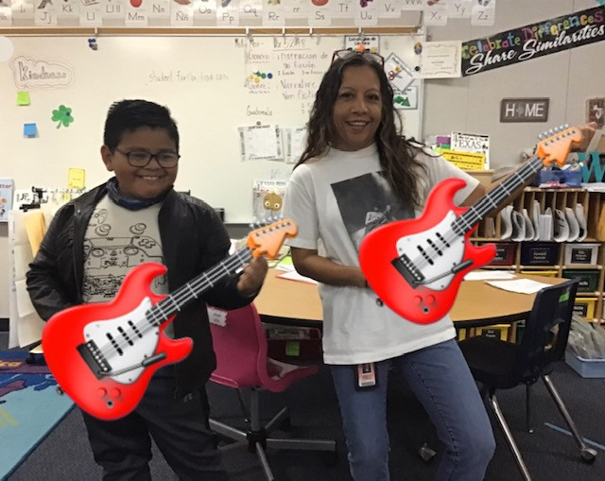
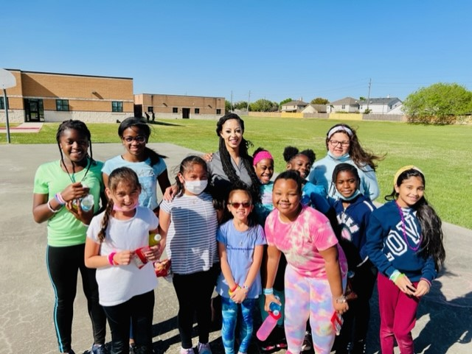
Holley Elementary Campus Wellness Committee Leader Nurse Angela McQuilken
Notes:
Time: 2 minutes
Speaker – Campus Wellness Committee Leaders Angela McQuilken from Holley Elementary
Say: Hi, I am Angela McQuilkin, the School Nurse at Mary Holley Elementary, which is a Title I school located in the 4 corners area of Houston. I am also the lead of the Wellness Committee. At MHE we do a lot to help promote wellness for students, staff and parents. We participate in ALL of the Awareness Days/Weeks and Months from Pediatric Cancer Awareness to Bullying Prevention Month/Red Ribbon Week to National Child Nutrition Month and a Very Fun School Breakfast Week and WATCH Week. We Wear Mismatched Socks for World Down Syndrome Day, Turn it Blue for Autism Awareness and Blue Ribbons for Child Abuse Prevention as well as many others in between.
We hold Biggest “Loser” Weight Loss Competitions for Staff to promote health and wellness. I take students to See to Succeed through the City of Houston Health Department, where students get a free vision exam and a free pair of glasses if needed. We also take our 2nd graders on a Project Saving Smiles Field Trip for dental hygiene education, cleaning and sealants.
Highlights of wellness for our campus this year have been the Kids Heart Challenge, Brighter Bites, Girls on the Run and Boys on the Right Track…
Kids Heart Challenge focuses on whole body wellness, helping students improve their own health and better their character while feeling great about themselves getting active and raising life-saving donations for the American Heart Association to help kids facing heart-health issues.
Brighter Bites is a nonprofit organization that partners with local food banks to distribute Fresh Fruits and Vegetables, Promote Fun Food Experiences and Teach Nutrition Education. We are fortunate to be able to participate in the program for 3 consecutive years. As of
April 19th, MHE has a total of 267 families/teachers/staff enrolled, we have distributed a total of 2,250 boxes equaling 44,486 pounds of fresh produce and we have had 302 produce activities taught so far. I am lucky to be one of the coaches for Girls on the Run, which was started this year, along with Boys on the Right Track. Both are social, emotional learning programs with a focus on being healthy in mind, body and soul. You can ask any participant, coach or family member and they can tell you how these programs have changed their lives in unimaginable ways. We had our Celebratory 5K at Rice University on April 30th. For their community impact project, the GOTR girls collected food, hygiene products and items for babies and infants for Women Connection, Inc., which is a local non-profit shelter for women and their children experiencing homelessness.
I am very proud of all the staff and students at Holley. We promote health and wellness in many ways and get the word out to staff, students and their families. We always have lots of participation, awareness and fun with all of our events.

Slide 9
Student Wellness Committees
Campus Name | Student Participation | Student Focus
Austin HS | 5 Students | Development of CWC
Bush HS | 20+ Students | Development of CWC
Clements HS | 10+ Students | Physical Health, Nutritional Health & SEL
Dulles HS | 10+ Students | Development of CWC
Elkins HS | 10+ Students | Development of CWC
Kempner HS | 10+ Students | Development of CWC
Ridge Point HS | 10+ Students | Development of CWC
Travis HS | 30+ Students | Development of CWC
Willowridge HS | 3 Students | Development of CWC
Notes:
Time: 30 seconds
Speaker – Melanie
Say: Student Wellness Committees now exist on most high school campuses. On this slide you will see a list of the high school campuses that have a Students Wellness Committee, the number of students participating, and the focus area determined by the students. We would like you to hear from the students driving health and wellness on their campuses.
Introduce students:
From Travis HS we have Ashley P. & from Bush HS joining us today is (Student names) – Add students’ speech here

Slide 10
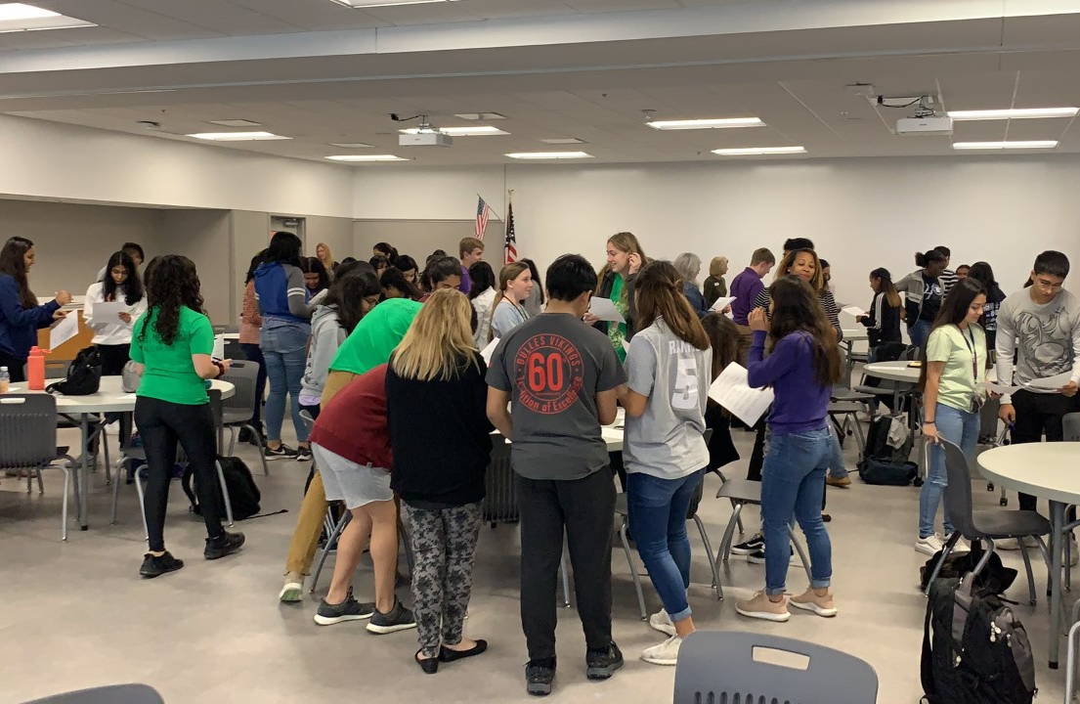
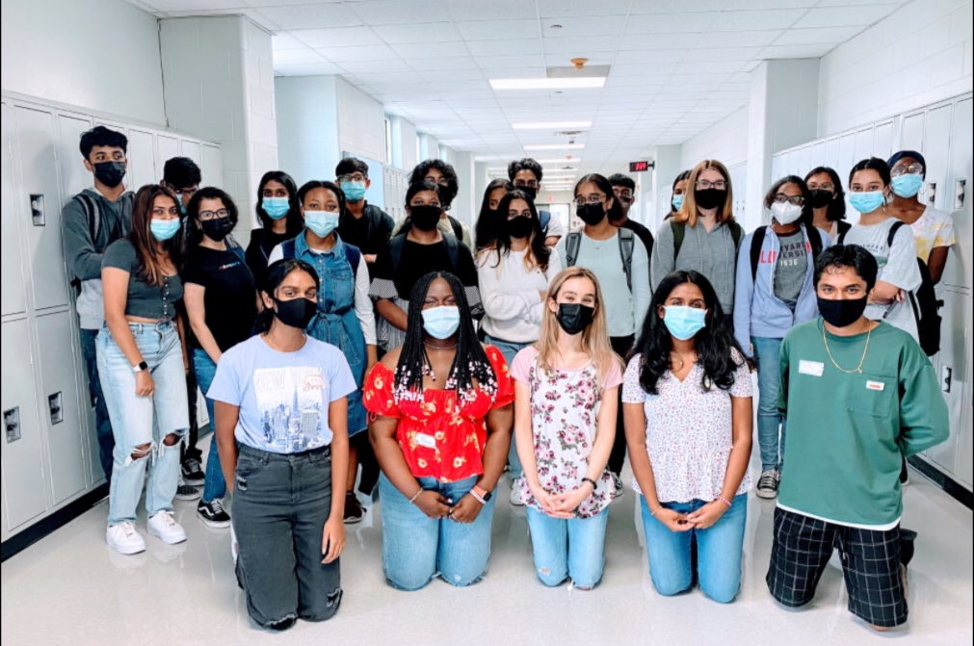
Student Wellness Committees
Student Wellness Committees
Notes:
Time: 2 minutes Speaker – Melanie & Ashley Poole (Travis HS Student)
Melanie
Say: Provide summary of the Student Wellness Committee and introduce student speaker.
Travis HS (Ashley P.)
Ashley Poole (Travis HS Student)
Say: Good evening. My name is Ashley Poole and I am member of the Student Wellness Committee at Travis High School.
Main Points:
Origins of the SWC Initiative within the Student Voices Advisory Network
Specific Travis Accomplishment
Say no to substance abuse signing day
Social nights for school
Collaboration with principals and counselors
Uplifting underclassmen to leadership
District Meetings and initiatives
SWC Chapter Meetings- Promoting wellness from the center of our team and outward
Social media influence
Coming- Serenity Room for THS Students
SWC Newsletter for virtual outreach

Slide 11
Whole Child Health in FBISD
Recommendations
Expansion of Action Based Learning Labs
.
Streamline communication channels/process to promote all Whole Child Health programs & resources in the District
03
Create incentives for Campus Wellness Champions
Continue to provide mental health supports for student and staff
Increase opportunities for high school students to engage in physical activity
02
04
Develop a process for providing SHAC input on WSCC policy development
01
05
Notes:
Program Implementation
Presenter: Allison Thummel
Time: 1 min
Say: SHACs continue to be vital to …….
Our recommendations going forward include:
Supporting expansion of ABL labs
Creating “alternative incentives” for staff to lead Campus Wellness Committees (since funding a stipend is not a feasible request at this time)
Alternative incentives for staff to support additional opportunities for high school students to be physically active - like keeping the weight room open or supporting a running or yoga club
Guidelines for effective promotion of all wellness programs - including lead time for advertising and coordination between departments
Continue mental health supports and programs for students and staff - review student counselor ratio
Develop a process for providing SHAC input on WSCC policy development

Slide 12
Questions
For more information about FBISD SHAC, visit www.fortbendisd.com/SHAC, follow us on Twitter @FBISD_SHAC or contact the SHAC Chair at chairfortbendisdshac@gmail.com
Notes:
Program Implementation
Presenter: Melanie Anbarci & Allison Thummel
Time: 30 seconds
Say: Thank you for your time tonight. At this time, we will take any questions.

